Slide 1

MINISTRY OF EDUCATION AND TRAINING
Capstone Project
Summer 2016
1
Hoa Lac, 31th August 2016
1

Slide 2
Olives
Healthcare Connected
2

Slide 3
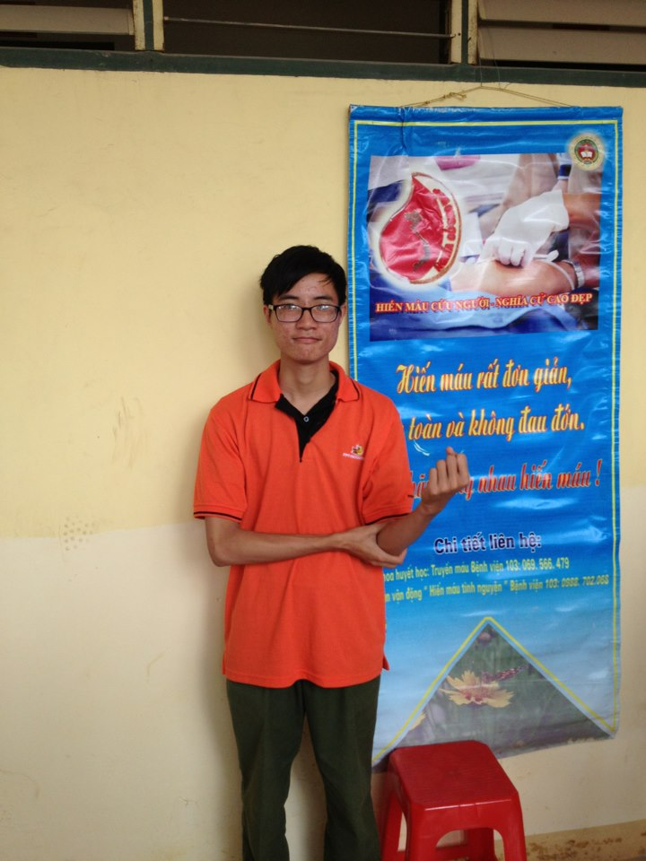
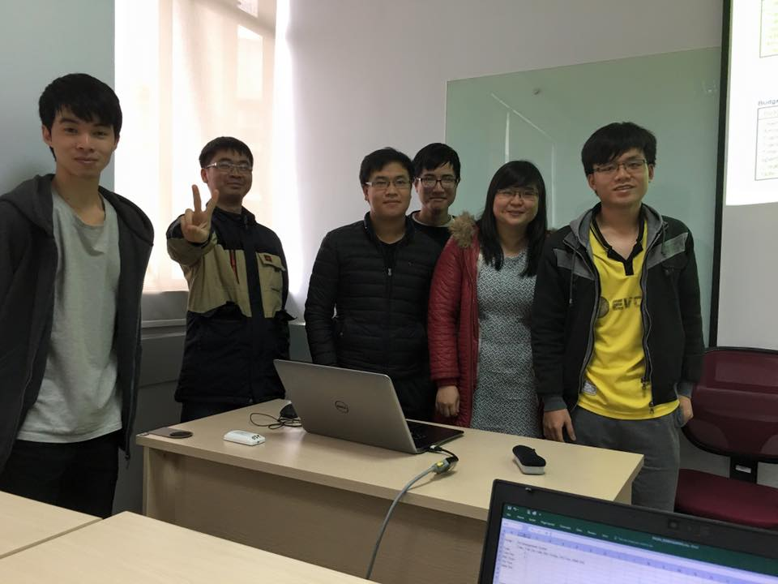





Team Member
Phạm Đức Thắng
Team Leader
Bùi Quốc Trọng
Team Member
Phạm Minh Tuấn
Team Member
Mr Phan Trường Lâm
Supervisor
Nguyễn Duy Linh
Team Member
Nguyễn Văn Hưng
Team Member
Trần Ánh Dương
Team Member
3

Slide 4
Introduction
Project Management Plan
Software Requirement Specification
Software Architectural Design
Tesing
Lesson Learned
Demo – QA
1
2
3
OUTLINE
4
5
6
7
4

Slide 5
Introduction
Project Management Plan
Software Requirement Specification
Software Architectural Design
Tesing
Lesson Learned
Demo – QA
1
2
3
OUTLINE
4
5
6
7
5

Slide 6
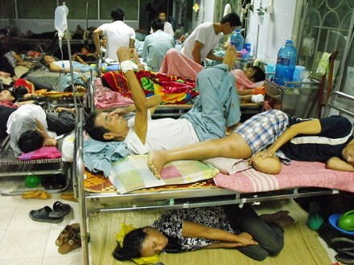
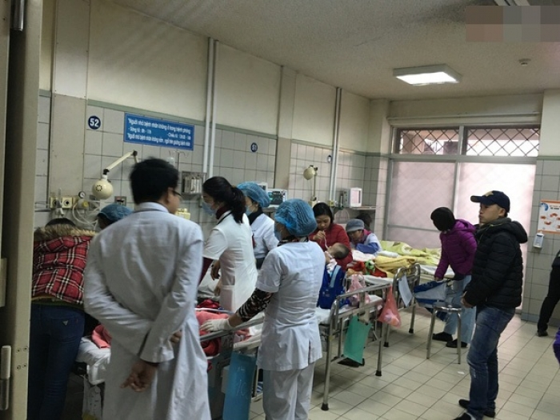
BACKGROUND
Quá tải giường bệnh
lên tới 120%
6

Slide 7

BACKGROUND
Kết nối giữa bác sĩ và bệnh nhân hầu như không có
7

Slide 8

BACKGROUND
Khó tiếp cận bác sĩ chuyên khoa giỏi
8

Slide 9
BACKGROUND
Khó nắm được tình trạng hàng ngày của bệnh nhân ngoại trú
9

Slide 10





10
OLIVES
Our Idea

Slide 11

Main Objectives
Find and contact with a doctor to get a treatment the way easier.
Check and manage information about the personal medical record’s data.
11

Slide 12
Scope
In scope
Out scope
Medical Record
Prescription
Doctor Page/ App
Patient Page/ App
Admin Page
Notification
Message
Appointment
Statistic
Payment
Video Call
Around Here
Native mobile apps
12

Slide 13
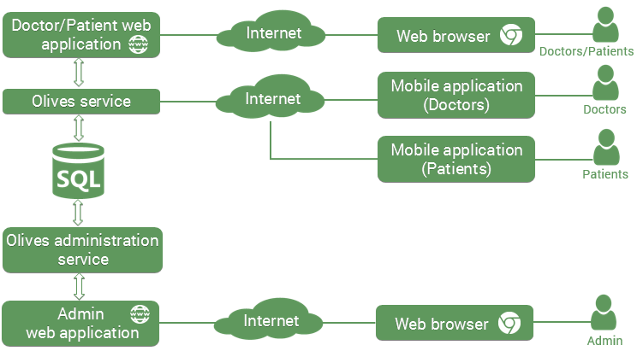
System Proposal
13

Slide 14
Introduction
Project Management Plan
Software Requirement Specification
Software Architectural Design
Tesing
Lesson Learned
Demo – QA
1
2
3
OUTLINE
4
5
6
7
14

Slide 15
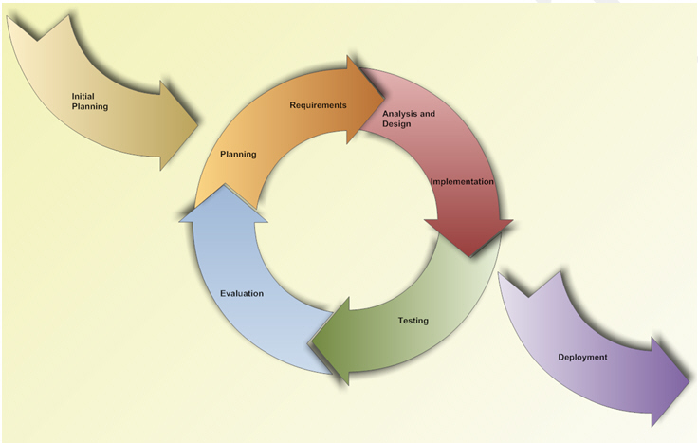
Software Process Model
15

Slide 16











Team Work
Time: 6 hours/day, 5 days/week.
Location: 105R – Anpha building.
Communication:
Meeting supervisor: Once a week.
Teambuilding: Once a month.
16

Slide 17
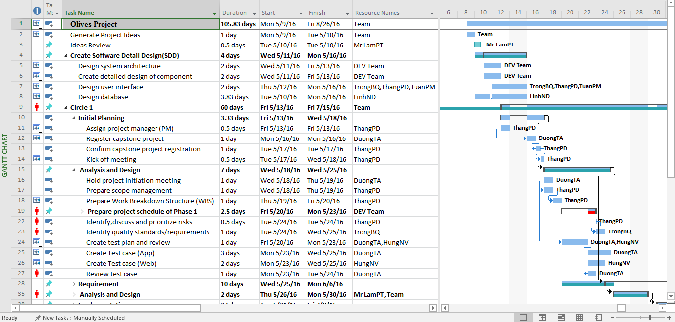
17
Project Plan

Slide 18










18
Project Tools
Google Chrome
Microsoft Office 2013
Enterprise Architect
Astah Professional
Redmine
Tortoisegit
SmartSVN
GitHub
Sublime text
Notepad ++

Slide 19








Project Tools
Source tree
Navicat
Web Pack
Postman
HTML & CSS
Xcode
Visual Studio community 2015
Visual studio code
19

Slide 20




Technologies
Microsoft ASP.NET
SQL Server Express
Type script
AngularJS2
20

Slide 21
Risk Management
21

Slide 22
No | Description | Root Cause | Avoidance Plan | Contingency plan | Probability | Impact | Status
R1 | The project is not on time. | - Underestimate time of project. - The scope of project is too big for team. - Spend too much time to research and study but don’t start coding. | - Keep track with capstone’s deadline. - Ask supervisor for advice to define suitable scope. - Put high priority on main functions. - Start coding as early as possible. | - Work together for tracking schedule. | Low | High | Close
R2 | The domain name has been bought. | The domain name for the website has been bought | Check the available of the domain name before decide to use | Have some back up domain name so we can use it if need. | Medium | Low | Close
R3 | Change version of iOS | Release new version of iOS with a lot of changes. | Can’t be avoid | Always make code clean so we can change it easier | Medium | High | Close
R4 | Difficult Problems | Project has technical issue which wastes time and cost to investigate | Learning technology clearly before starting project | Limit related function | Medium | Medium | Close
R5 | Changes of team member | New member join or old member out. | Minimum the changes | Require the member who left hand over the work carefully | Medium | High | Close
R6 | Total cost increase | The total amount of money increase and can’t be controlled. | Have good plan to control the cost and make prediction about the total cost carefully | QA check the report about the money used carefully | Medium | Medium | Close
22

Slide 23
Introduction
Project Management Plan
Software Requirement Specification
Software Architectural Design
Tesing
Lesson Learned
Demo – QA
1
2
3
OUTLINE
4
5
6
7
23

Slide 24
Use Case Diagram
Guest
Doctor
Patient
Admin
100
Use case
24

Slide 25
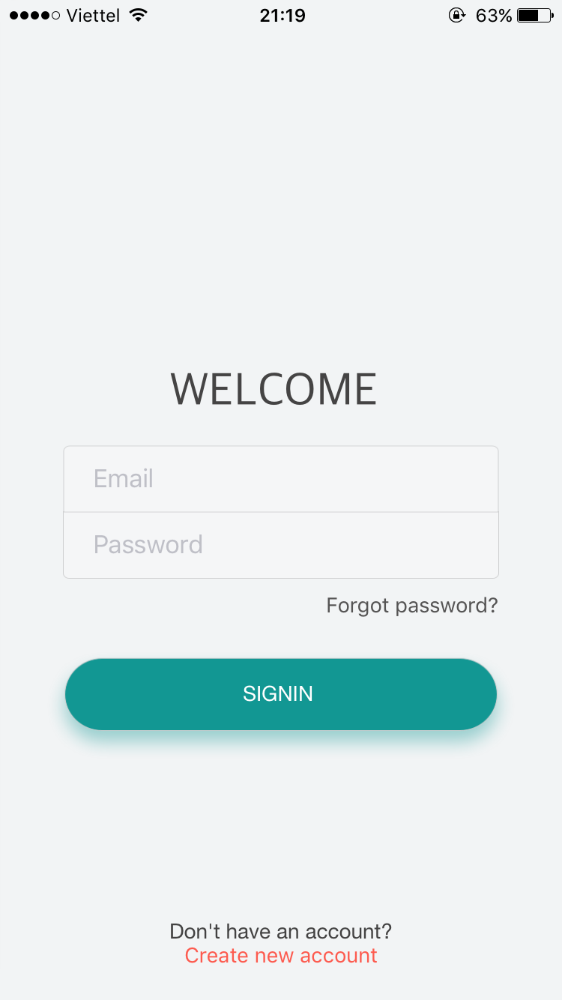
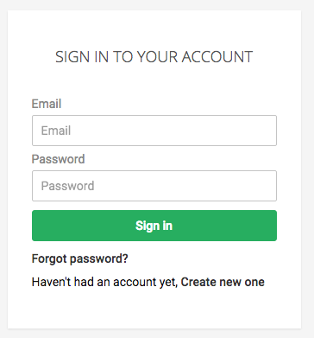
Guest
Login
Register
Search Doctor
View Profile Doctor
25

Slide 26
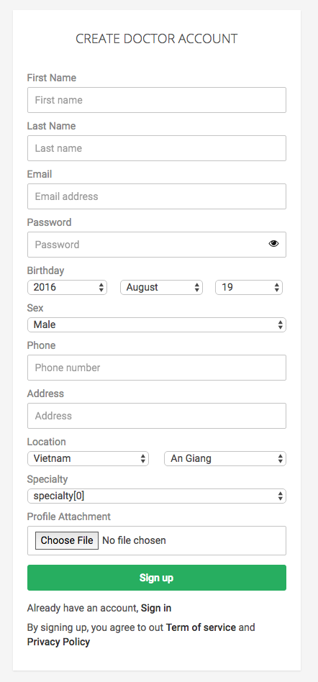
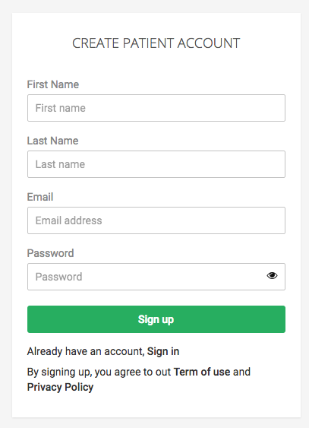
Guest
Login
Register
Search Doctor
View Profile Doctor
26

Slide 27
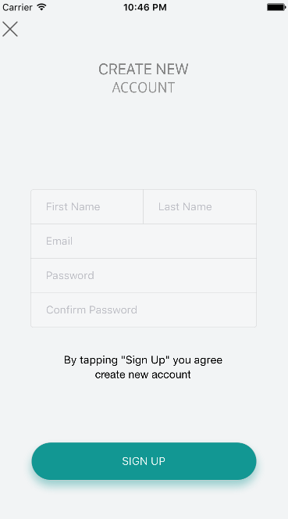
Guest
Login
Register
Search Doctor
View Profile Doctor
27

Slide 28
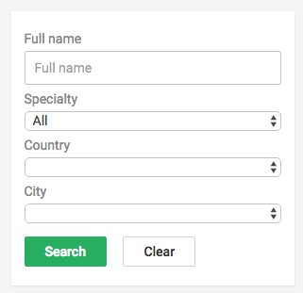
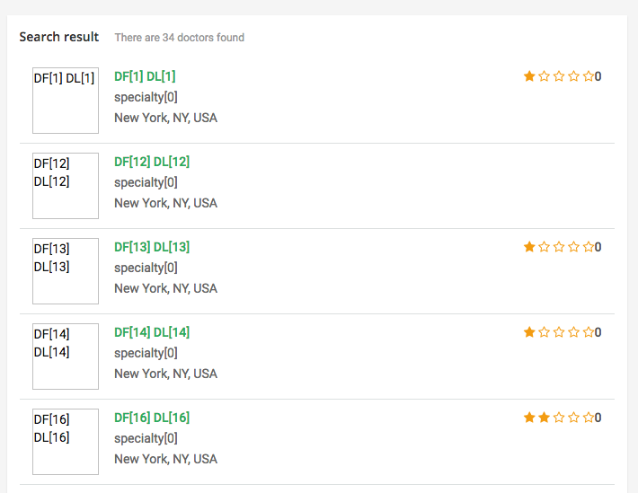
Guest
Login
Register
Search Doctor
View Profile Doctor
28

Slide 29
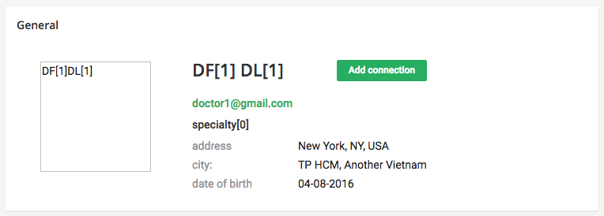
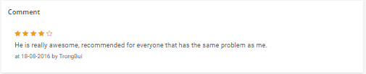
Guest
Login
Register
Search Doctor
View Profile Doctor
29

Slide 30
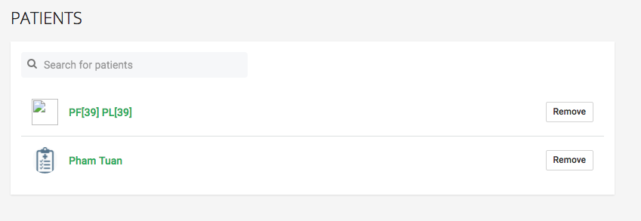
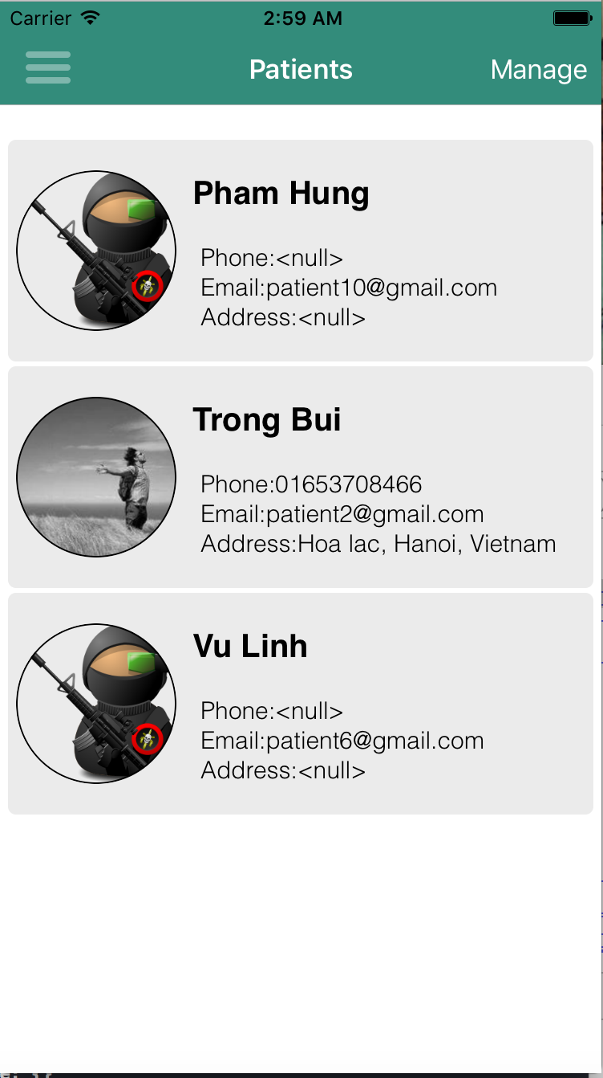
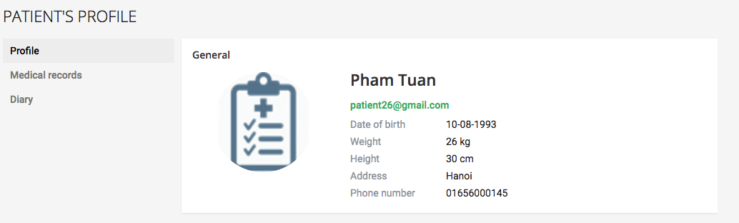
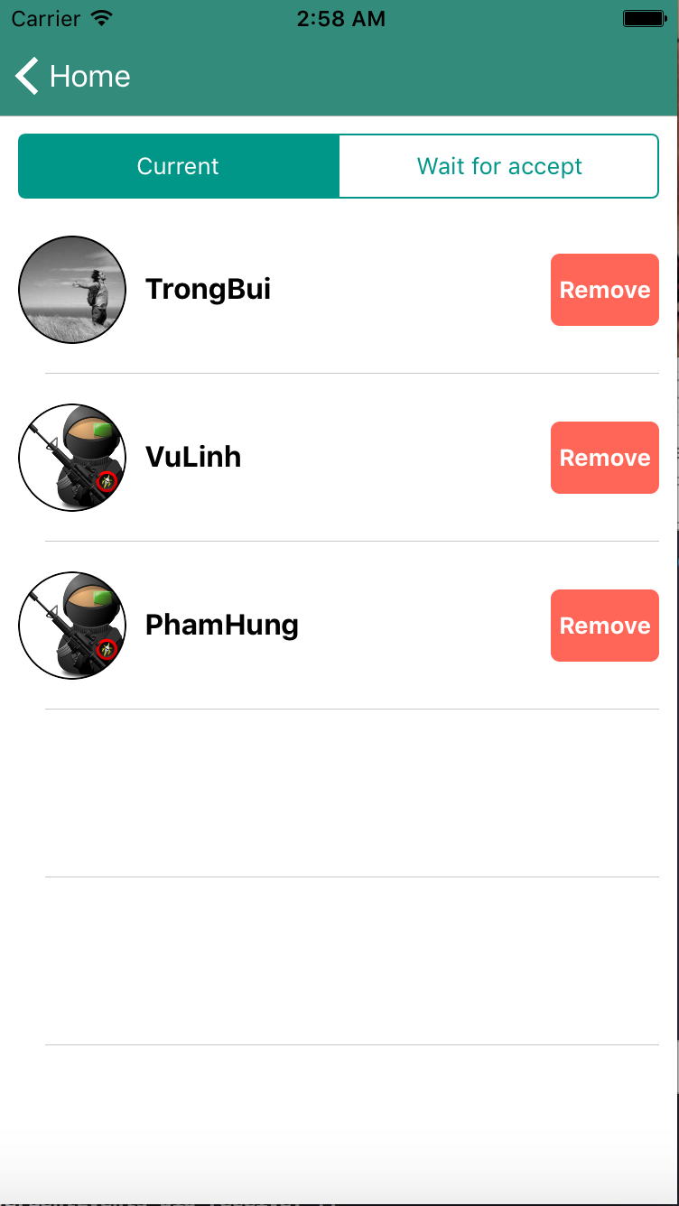
Doctor User
Manager Patient
Accept patient request
View Patient Daily Record
Manager Appointment
Manager Medical Record
Manager Prescription
Manager Diary
Chat With Patient
Notification
View Comment
30

Slide 31
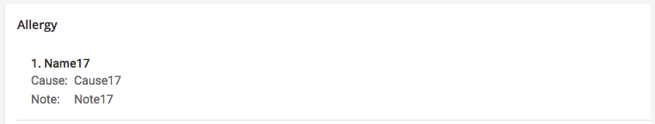
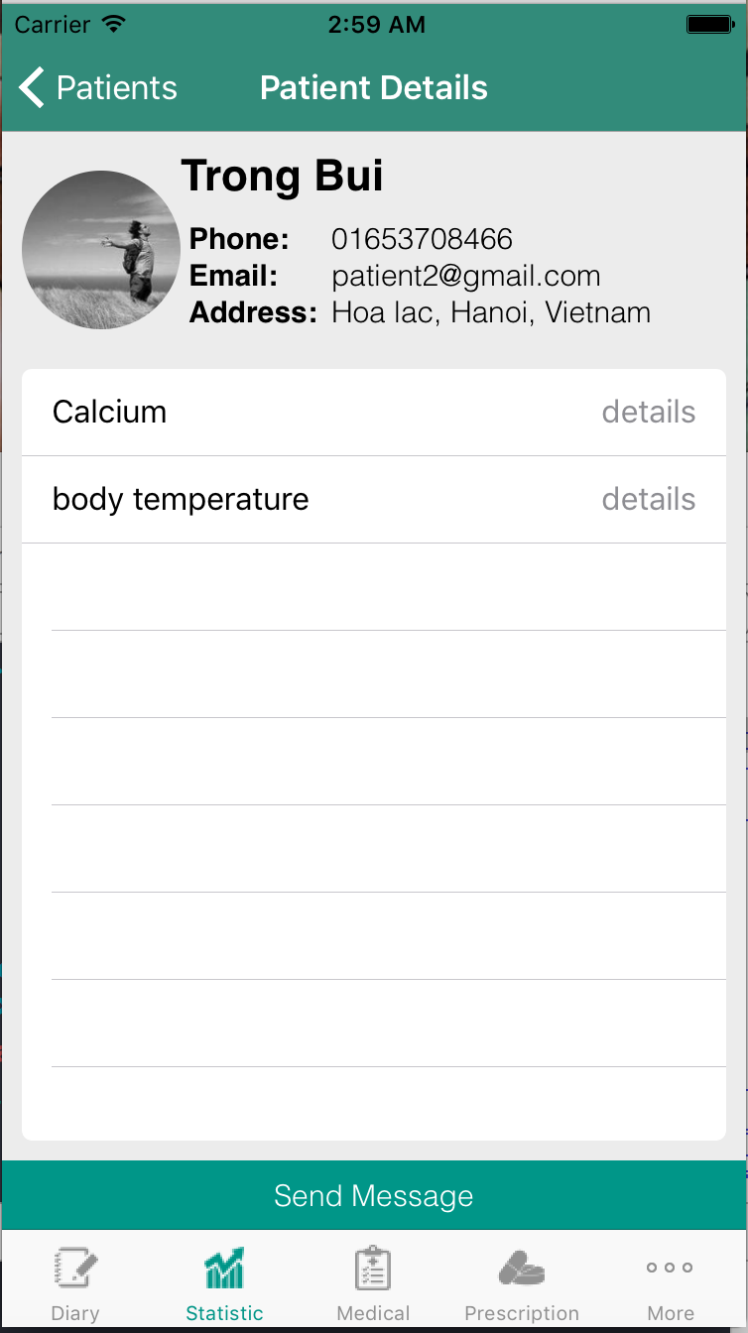
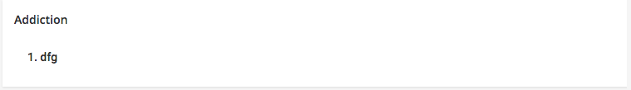
Doctor User
Manager Patient
Accept patient request
View Patient Daily Record
Manager Appointment
Manager Medical Record
Manager Prescription
Manager Diary
Chat With Patient
Notification
View Comment
31

Slide 32
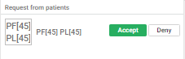
Doctor User
Manager Patient
Accept patient request
View Patient Daily Record
Manager Appointment
Manager Medical Record
Manager Prescription
Manager Diary
Chat With Patient
Notification
View Comment
32

Slide 33
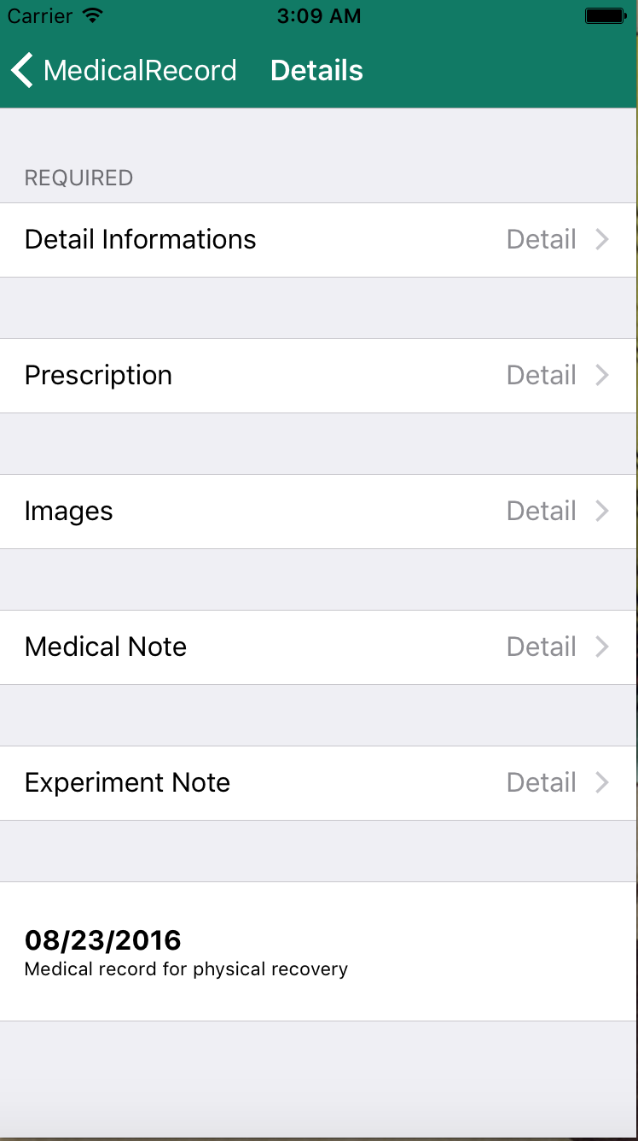
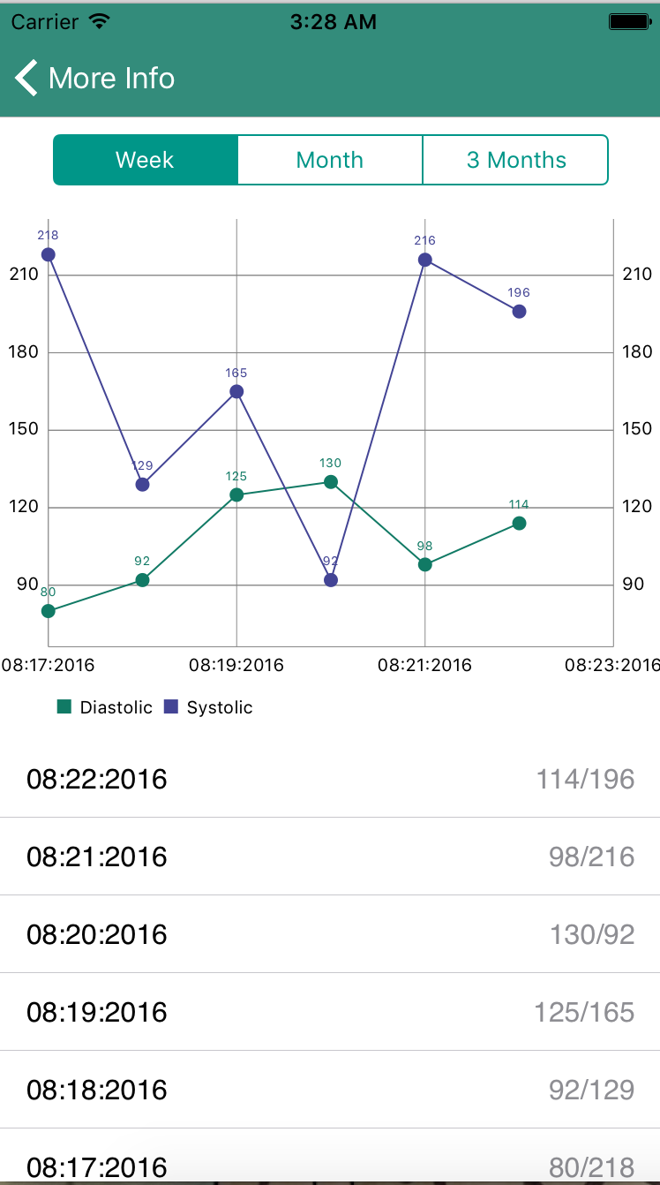
Doctor User
Manager Patient
Accept patient request
View Patient Daily Record
Manager Appointment
Manager Medical Record
Manager Prescription
Manager Diary
Chat With Patient
Notification
View Comment
33

Slide 34
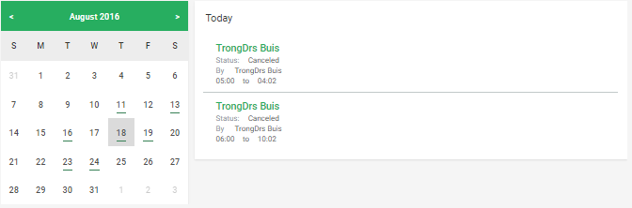
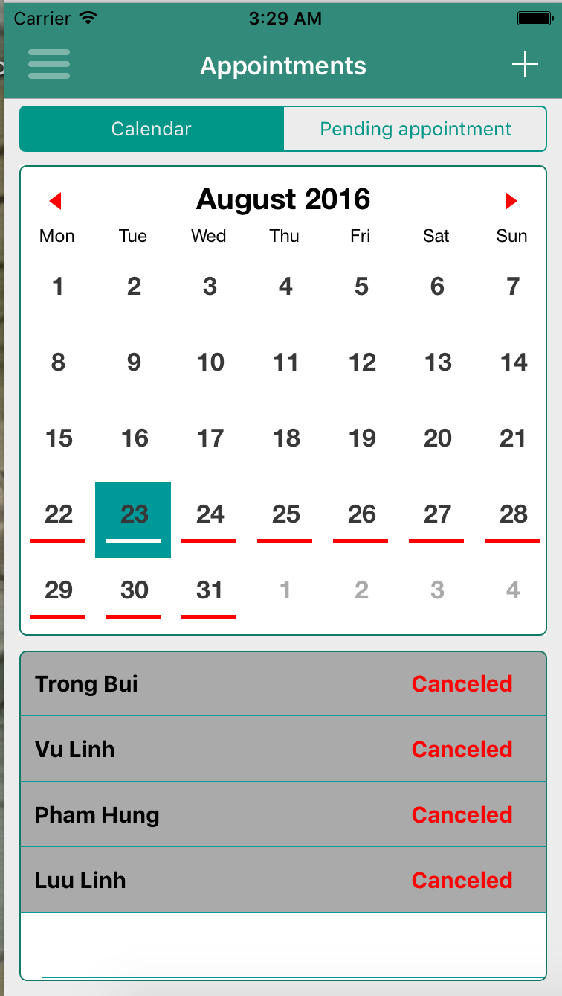
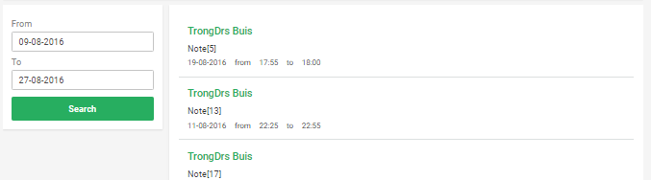
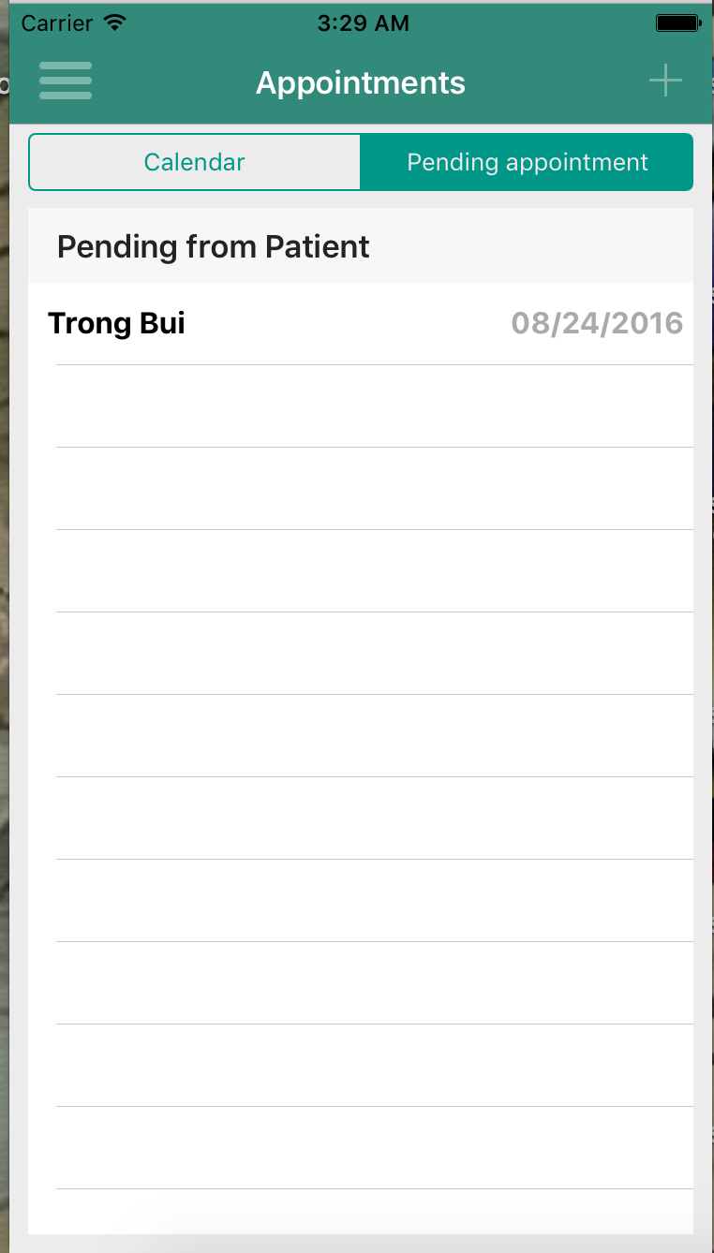
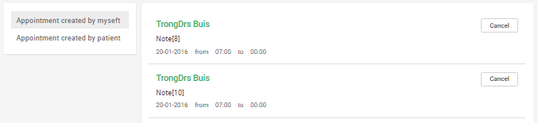
Doctor User
Manager Patient
Accept patient request
View Patient Daily Record
Manager Appointment
Manager Medical Record
Manager Prescription
Manager Diary
Chat With Patient
Notification
View Comment
34

Slide 35
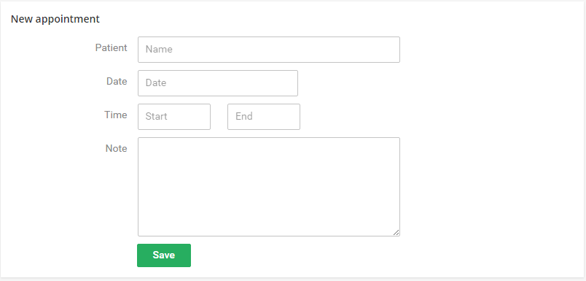
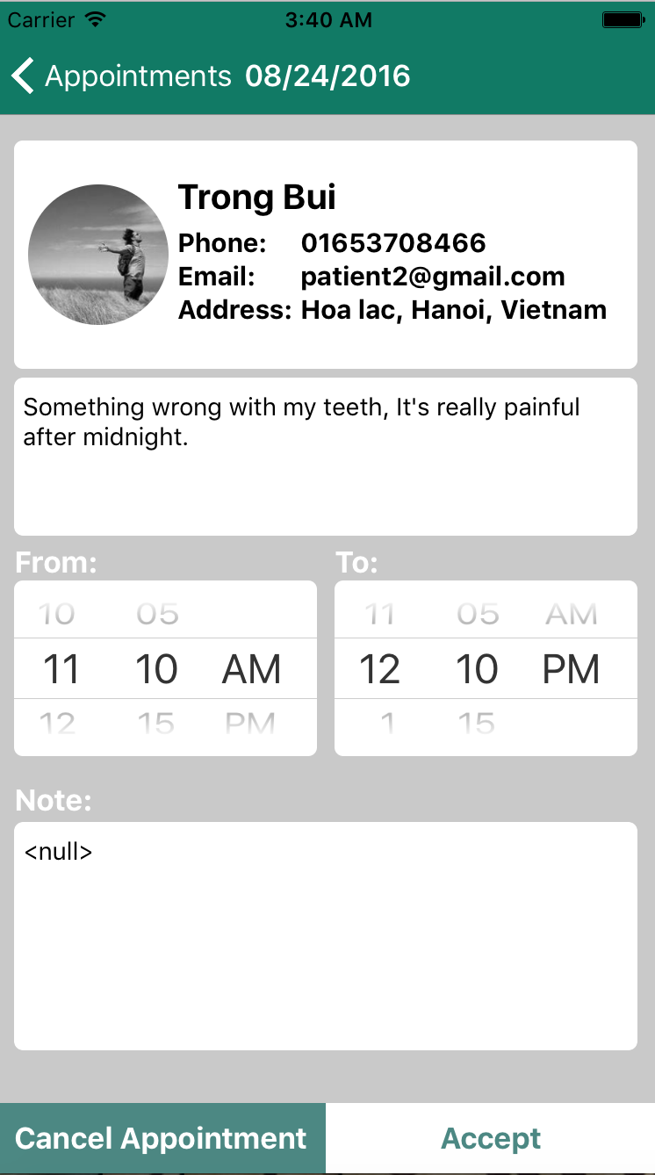
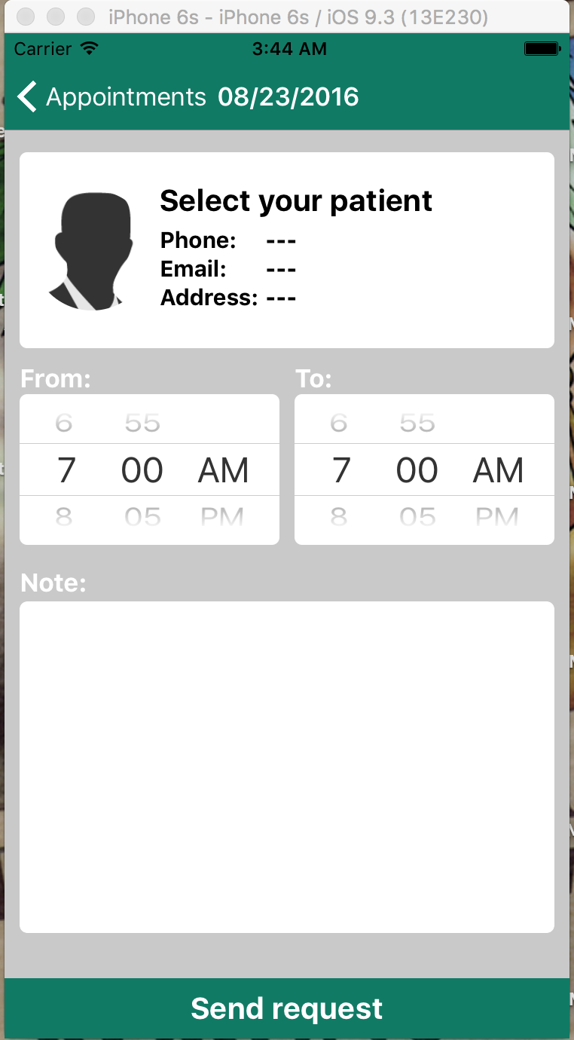
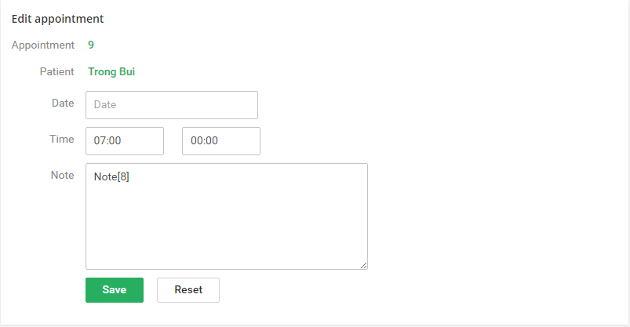
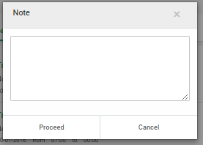
Doctor User
Manager Patient
Accept patient request
View Patient Daily Record
Manager Appointment
Manager Medical Record
Manager Prescription
Manager Diary
Chat With Patient
Notification
View Comment
35

Slide 36
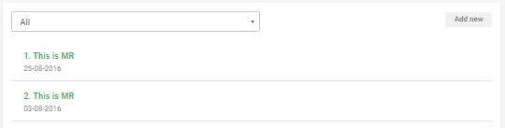
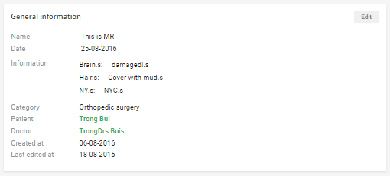
Doctor User
Manager Patient
Accept patient request
View Patient Daily Record
Manager Appointment
Manager Medical Record
Manager Prescription
Manager Diary
Chat With Patient
Notification
View Comment
36

Slide 37
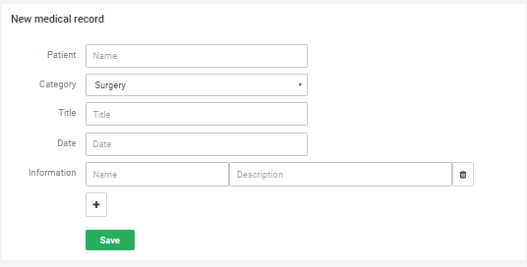
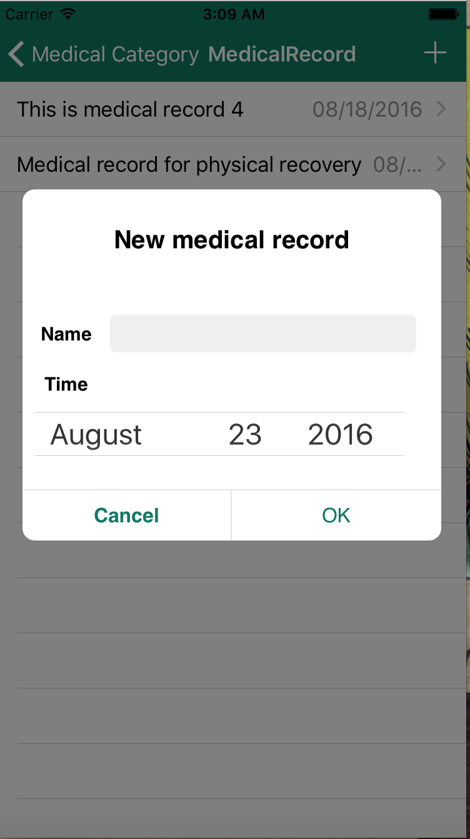
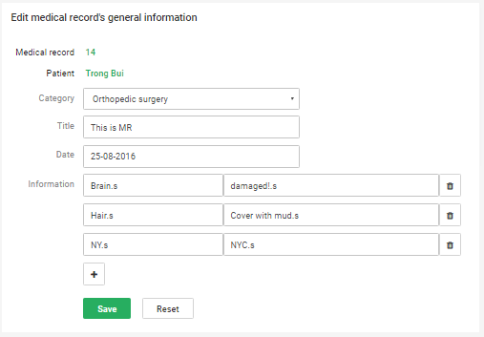
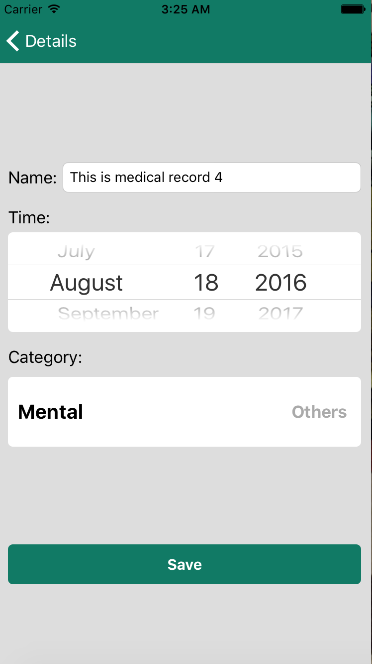
Doctor User
Manager Patient
Accept patient request
View Patient Daily Record
Manager Appointment
Manager Medical Record
Manager Prescription
Manager Diary
Chat With Patient
Notification
View Comment
37

Slide 38
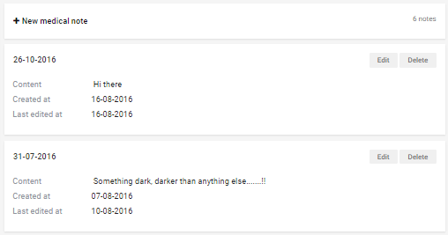
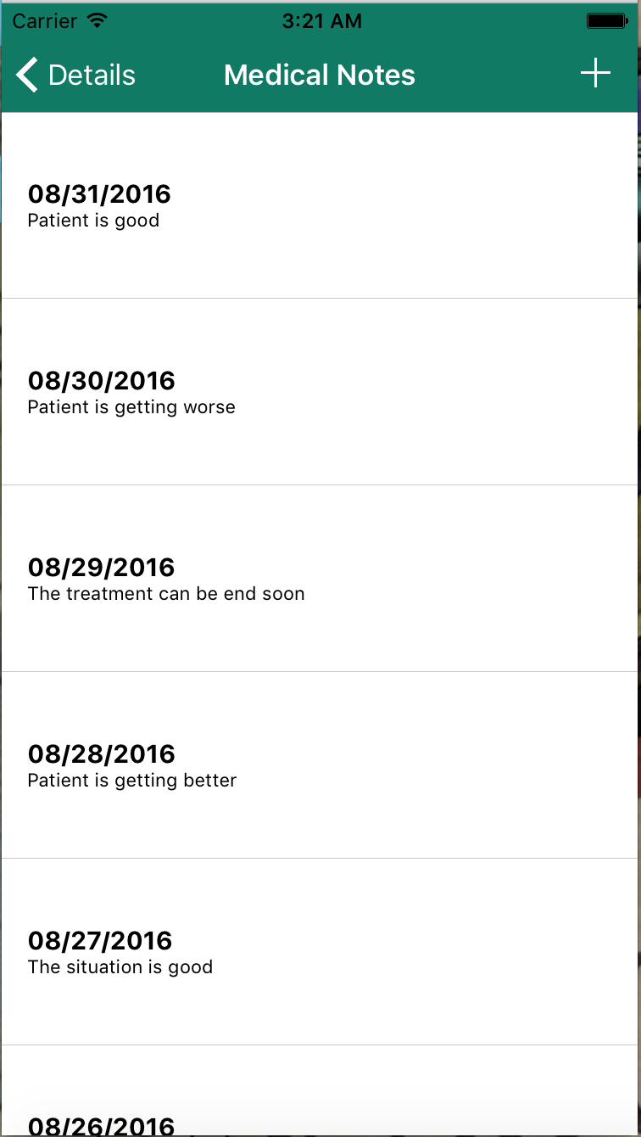
Doctor User
Manager Patient
Accept patient request
View Patient Daily Record
Manager Appointment
Manager Medical Record
Manager Prescription
Manager Diary
Chat With Patient
Notification
View Comment
38

Slide 39
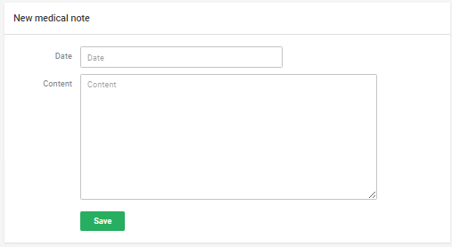
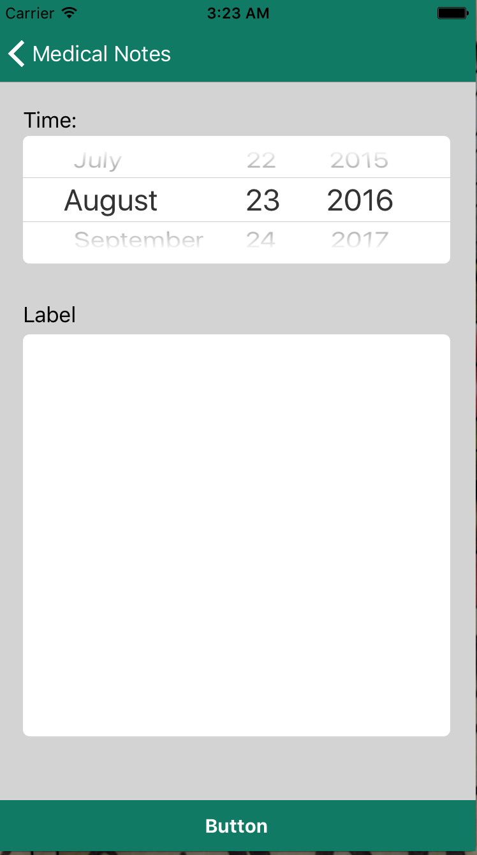
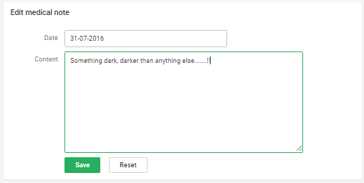
Doctor User
Manager Patient
Accept patient request
View Patient Daily Record
Manager Appointment
Manager Medical Record
Manager Prescription
Manager Diary
Chat With Patient
Notification
View Comment
39

Slide 40
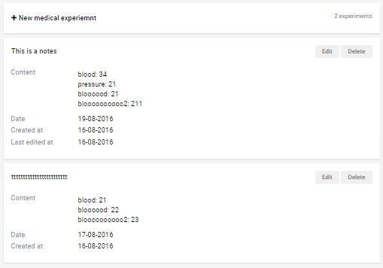
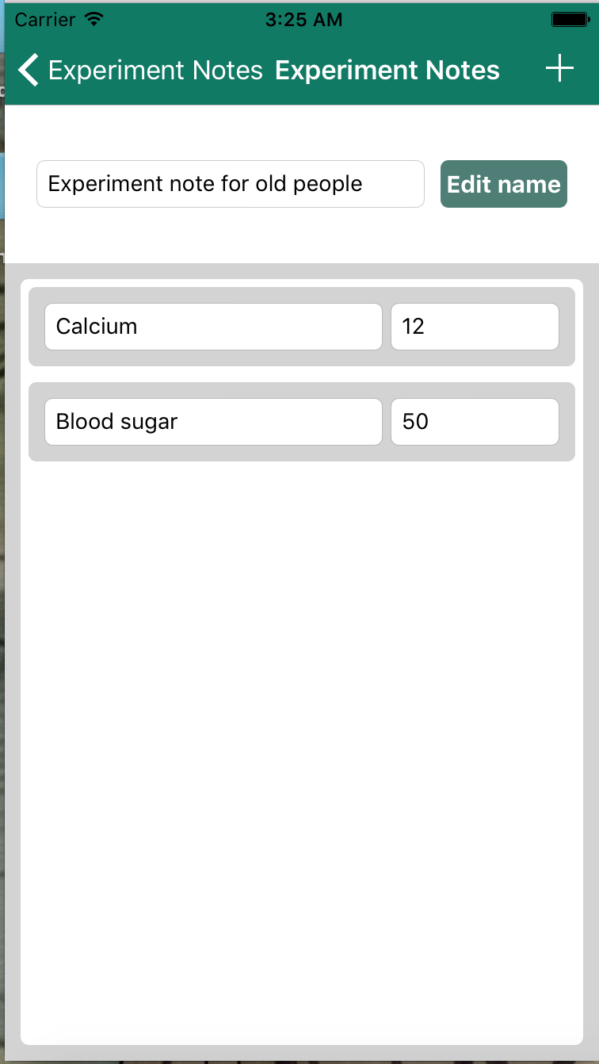
Doctor User
Manager Patient
Accept patient request
View Patient Daily Record
Manager Appointment
Manager Medical Record
Manager Prescription
Manager Diary
Chat With Patient
Notification
View Comment
40

Slide 41
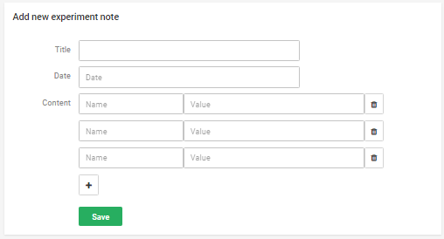



Doctor User
Manager Patient
Accept patient request
View Patient Daily Record
Manager Appointment
Manager Medical Record
Manager Prescription
Manager Diary
Chat With Patient
Notification
View Comment
41

Slide 42




Doctor User
Manager Patient
Accept patient request
View Patient Daily Record
Manager Appointment
Manager Medical Record
Manager Prescription
Manager Diary
Chat With Patient
Notification
View Comment
42

Slide 43


Doctor User
Manager Patient
Accept patient request
View Patient Daily Record
Manager Appointment
Manager Medical Record
Manager Prescription
Manager Diary
Chat With Patient
Notification
View Comment
43

Slide 44



Doctor User
Manager Patient
Accept patient request
View Patient Daily Record
Manager Appointment
Manager Medical Record
Manager Prescription
Manager Diary
Chat With Patient
Notification
View Comment
44

Slide 45



Doctor User
Manager Patient
Accept patient request
View Patient Daily Record
Manager Appointment
Manager Medical Record
Manager Prescription
Manager Diary
Chat With Patient
Notification
View Comment
45

Slide 46




Doctor User
Manager Patient
Accept patient request
View Patient Daily Record
Manager Appointment
Manager Medical Record
Manager Prescription
Manager Diary
Chat With Patient
Notification
View Comment
46

Slide 47



Doctor User
Manager Patient
Accept patient request
View Patient Daily Record
Manager Appointment
Manager Medical Record
Manager Prescription
Manager Diary
Chat With Patient
Notification
View Comment
47

Slide 48


Doctor User
Manager Patient
Accept patient request
View Patient Daily Record
Manager Appointment
Manager Medical Record
Manager Prescription
Manager Diary
Chat With Patient
Notification
View Comment
48

Slide 49



Doctor User
Manager Patient
Accept patient request
View Patient Daily Record
Manager Appointment
Manager Medical Record
Manager Prescription
Manager Diary
Chat With Patient
Notification
View Comment
49

Slide 50

Doctor User
Manager Patient
Accept patient request
View Patient Daily Record
Manager Appointment
Manager Medical Record
Manager Prescription
Manager Diary
Chat With Patient
Notification
View Comment
50

Slide 51


Doctor User
Manager Patient
Accept patient request
View Patient Daily Record
Manager Appointment
Manager Medical Record
Manager Prescription
Manager Diary
Chat With Patient
Notification
View Comment
51

Slide 52
Doctor User
Manager Patient
Accept patient request
View Patient Daily Record
Manager Appointment
Manager Medical Record
Manager Prescription
Manager Diary
Chat With Patient
Notification
View Comment
52

Slide 53




Doctor User
Setting
Sign in
Sign out
53

Slide 54


Patient User
Find Doctor
View Rate Doctor
Manage Profile
Manager Stats
Manager Appointment
Manager Medical Record
Manager Prescription
Chat With Doctor
Notification
Sign in / Sign up
54

Slide 55


Patient User
Find Doctor
View Rate Doctor
Manage Profile
Manager Stats
Manager Appointment
Manager Medical Record
Manager Prescription
Chat With Doctor
Notification
Sign in / Sign up
55

Slide 56

Patient User
Find Doctor
View Rate Doctor
Manage Profile
Manager Stats
Manager Appointment
Manager Medical Record
Manager Prescription
Chat With Doctor
Notification
Sign in / Sign up
56

Slide 57



Patient User
Find Doctor
View Rate Doctor
Manage Profile
Manager Stats
Manager Appointment
Manager Medical Record
Manager Prescription
Chat With Doctor
Notification
Sign in / Sign up
57

Slide 58




Patient User
Find Doctor
View Rate Doctor
Manager Profile
Manager Stats
Manager Appointment
Manager Medical Record
Manager Prescription
Chat With Doctor
Notification
Sign in / Sign up
58

Slide 59




Patient User
Find Doctor
View Rate Doctor
Manager Profile
Manager Stats
Manager Appointment
Manager Medical Record
Manager Prescription
Chat With Doctor
Notification
Sign in / Sign up
59

Slide 60


Patient User
Find Doctor
View Rate Doctor
Manage Profile
Manager Stats
Manager Appointment
Manager Medical Record
Manager Prescription
Chat With Doctor
Notification
Sign in / Sign up
60

Slide 61



Patient User
Find Doctor
View Rate Doctor
Manage Profile
Manager Stats
Manager Appointment
Manager Medical Record
Manager Prescription
Chat With Doctor
Notification
Sign in / Sign up
61

Slide 62

Patient User
Find Doctor
View Rate Doctor
Manage Profile
Manager Stats
Manager Appointment
Manager Medical Record
Manager Prescription
Chat With Doctor
Notification
Sign in / Sign up
62

Slide 63


Patient User
Find Doctor
View Rate Doctor
Manage Profile
Manager Stats
Manager Appointment
Manager Medical Record
Manager Prescription
Chat With Doctor
Notification
Sign in / Sign up
63

Slide 64


Patient User
Find Doctor
View Rate Doctor
Manage Profile
Manager Stats
Manager Appointment
Manager Medical Record
Manager Prescription
Chat With Doctor
Notification
Sign in / Sign up
64

Slide 65

Patient User
Find Doctor
View Rate Doctor
Manage Profile
Manager Stats
Manager Appointment
Manager Medical Record
Manager Prescription
Chat With Doctor
Notification
Sign in / Sign up
65

Slide 66

Patient User
Find Doctor
View Rate Doctor
Manage Profile
Manager Stats
Manager Appointment
Manager Medical Record
Manager Prescription
Chat With Doctor
Notification
Sign in / Sign up
66

Slide 67

Patient User
Find Doctor
View Rate Doctor
Manage Profile
Manager Stats
Manager Appointment
Manager Medical Record
Manager Prescription
Chat With Doctor
Notification
Sign in / Sign up
67

Slide 68

Patient User
Find Doctor
View Rate Doctor
Manage Profile
Manager Stats
Manager Appointment
Manager Medical Record
Manager Prescription
Chat With Doctor
Notification
Sign in / Sign up
68

Slide 69

Patient User
Find Doctor
View Rate Doctor
Manage Profile
Manager Stats
Manager Appointment
Manager Medical Record
Manager Prescription
Chat With Doctor
Notification
Sign in / Sign up
69

Slide 70

Patient User
Find Doctor
View Rate Doctor
Manage Profile
Manager Stats
Manager Appointment
Manager Medical Record
Manager Prescription
Chat With Doctor
Notification
Sign in / Sign up
70

Slide 71


Patient User
Find Doctor
View Rate Doctor
Manage Profile
Manager Stats
Manager Appointment
Manager Medical Record
Manager Prescription
Chat With Doctor
Notification
Sign in / Sign up
71

Slide 72


Patient User
Find Doctor
View Rate Doctor
Manage Profile
Manager Stats
Manager Appointment
Manager Medical Record
Manager Prescription
Chat With Doctor
Notification
Sign in / Sign up
72

Slide 73

Patient User
Find Doctor
View Rate Doctor
Manage Profile
Manager Stats
Manager Appointment
Manager Medical Record
Manager Prescription
Chat With Doctor
Notification
Sign in / Sign up
73

Slide 74

Patient User
Find Doctor
View Rate Doctor
Manage Profile
Manager Stats
Manager Appointment
Manager Medical Record
Manager Prescription
Chat With Doctor
Notification
Sign in / Sign up
74

Slide 75

Patient User
Find Doctor
View Rate Doctor
Manage Profile
Manager Stats
Manager Appointment
Manager Medical Record
Manager Prescription
Chat With Doctor
Notification
Sign in / Sign up
75

Slide 76

Patient User
Find Doctor
View Rate Doctor
Manage Profile
Manager Stats
Manager Appointment
Manager Medical Record
Manager Prescription
Chat With Doctor
Notification
Sign in / Sign up
76

Slide 77

Patient User
Find Doctor
View Rate Doctor
Manage Profile
Manager Stats
Manager Appointment
Manager Medical Record
Manager Prescription
Chat With Doctor
Notification
Sign in / Sign up
77

Slide 78



Patient User
Find Doctor
View Rate Doctor
Manage Profile
Manager Stats
Manager Appointment
Manager Medical Record
Manager Prescription
Chat With Doctor
Notification
Sign in / Sign up
78

Slide 79

Admin
Manager Doctor Request
Manager Patient
Manager Doctor
Manager Place
Manager Category
Sign In / Sign Out
79

Slide 80


Admin
Manager Doctor Request
Manager Patient
Manager Doctor
Manager Place
Manager Category
Sign In / Sign Out
80

Slide 81

Admin
Manager Doctor Request
Manager Patient
Manager Doctor
Manager Place
Manager Category
Sign In / Sign Out
81

Slide 82



Admin
Manager Doctor Request
Manager Patient
Manager Doctor
Manager Place
Manager Category
Sign In / Sign Out
82

Slide 83



Admin
Manager Doctor Request
Manager Patient
Manager Doctor
Manager Place
Manager Category
Sign In / Sign Out
83

Slide 84
Admin
Manager Doctor Request
Manager Patient
Manager Doctor
Manager Place
Manager Category
Sign In / Sign Out
84

Slide 85
Non-function requirement
Usability | Security | Maintainability | Performance
The user interface should be elegant, simple easy to use. | Apply social network (Facebook, Google, Twitter) token to restrict user access. | Follow coding convention, comment before each function. | Database in 3NF.
 |  | Follow Object – Oriented - Programing paradigm. | Review code to reduce unnecessary code.
 |  | Follow layered architecture, modular software and component- based development.
85

Slide 86
Introduction
Project Management Plan
Software Requirement Specification
Software Architectural Design
Tesing
Lesson Learned
Demo – QA
1
2
3
OUTLINE
4
5
6
7
86

Slide 87

Architectural Design
Olives
Application
59
Use Case
Advantages of using AngularJS
Model – View – Whatever pattern
Two way data binding
Route
Templates
Olives Administration sub-system
87

Slide 88

88
Olives
Application
59
Use Case
Advantages of using AngularJS
Model – View – Whatever pattern
Two way data binding
Route
Templates
Olives sub-system
Architectural Design

Slide 89



Real – Time Architectural Overview
Save connection index to SQL
Use
Interaction
Broadcast
Connect, interact
89

Slide 90

Notification Flowchart
Real-time connection initialization
Email&password
correct?
Start
Connect to
NotificationHub
Yes
No
Save connection
index to database
End
90

Slide 91
Notification Flowchart
Real-time notification broadcast
Make appointment/
Medical record/
Message
Information is
valid
Start
No
Yes
Find connection indexes match with recipient
Respond error
Broadcast notification
Respond HttpStatusCode
End
91

Slide 92

Database Design
92

Slide 93
Class diagram
93

Slide 94
Sequence diagram
94

Slide 95
Introduction
Project Management Plan
Software Requirement Specification
Software Architectural Design
Tesing
Lesson Learned
Demo – QA
1
2
3
OUTLINE
4
5
6
7
95

Slide 96
Identify Requirement
Test Planning
Test result report
Bug fixing
Design Test Case
Test Excuting
Acceptance Testing
Regression Testing
Testing Life
Cycle
96

Slide 97
Unit Testing
GUI Testing
Testing Type
Function Testing
Regression Testing
Acceptance Testing
97

Slide 98



Testing Tools

